Slide 1
Looking at Visual Attention in Value-Based Decision Making
Brenden Eum
SDN Proseminar

Slide 2
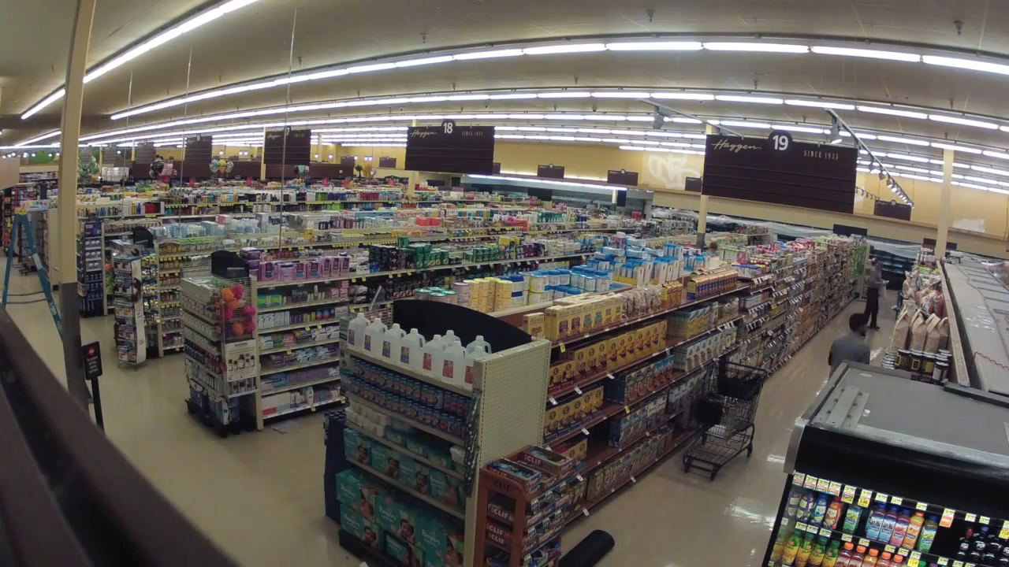


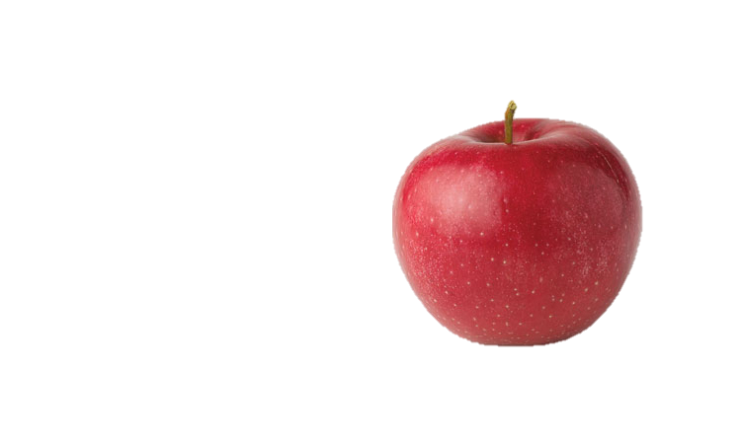

Slide 3
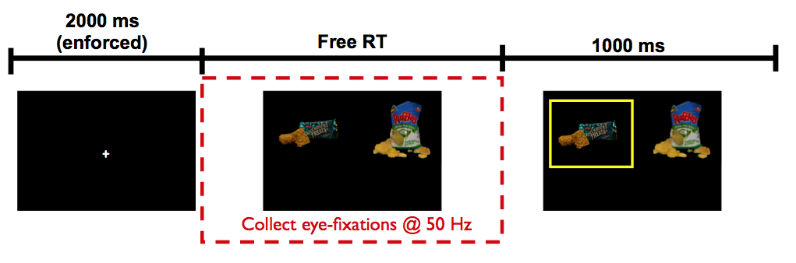
Krajbich, Armel, Rangel (2010, Nat Neuro)

Slide 4
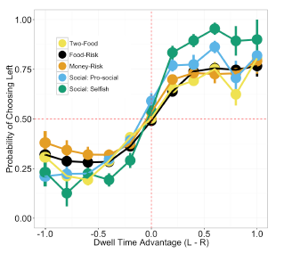
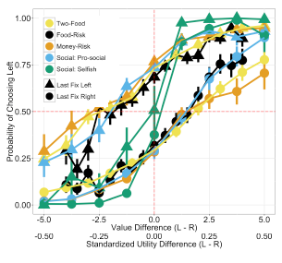
Net Fixation Bias
Last Fixation Bias
Smith, Krajbich (2018, J Exp Psychol Gen)
Notes:
multiple domains

Slide 5
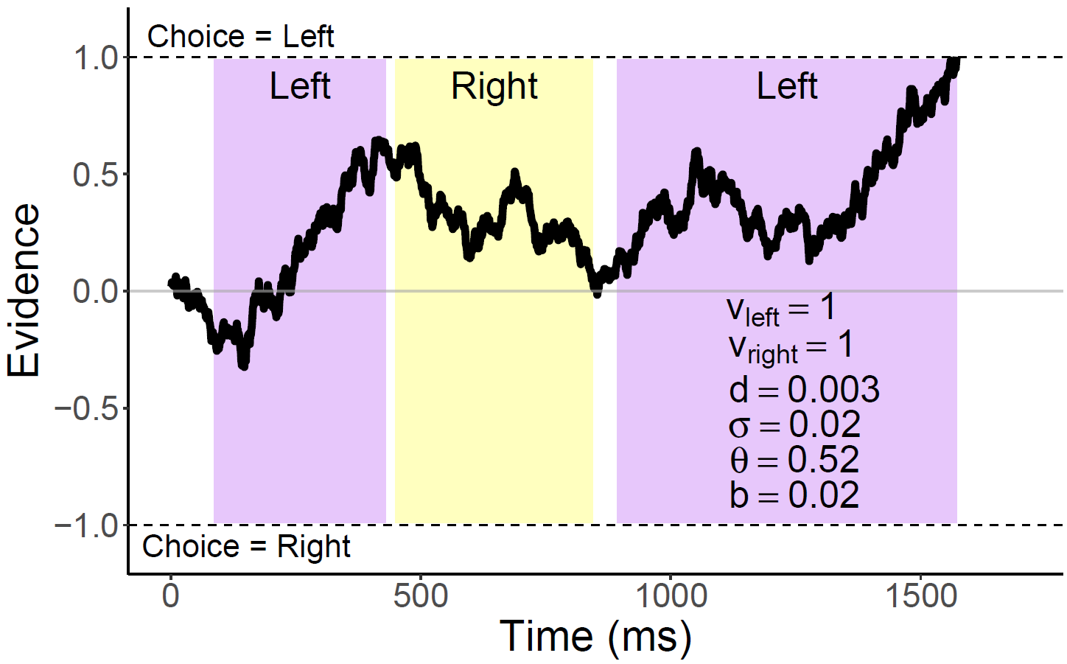
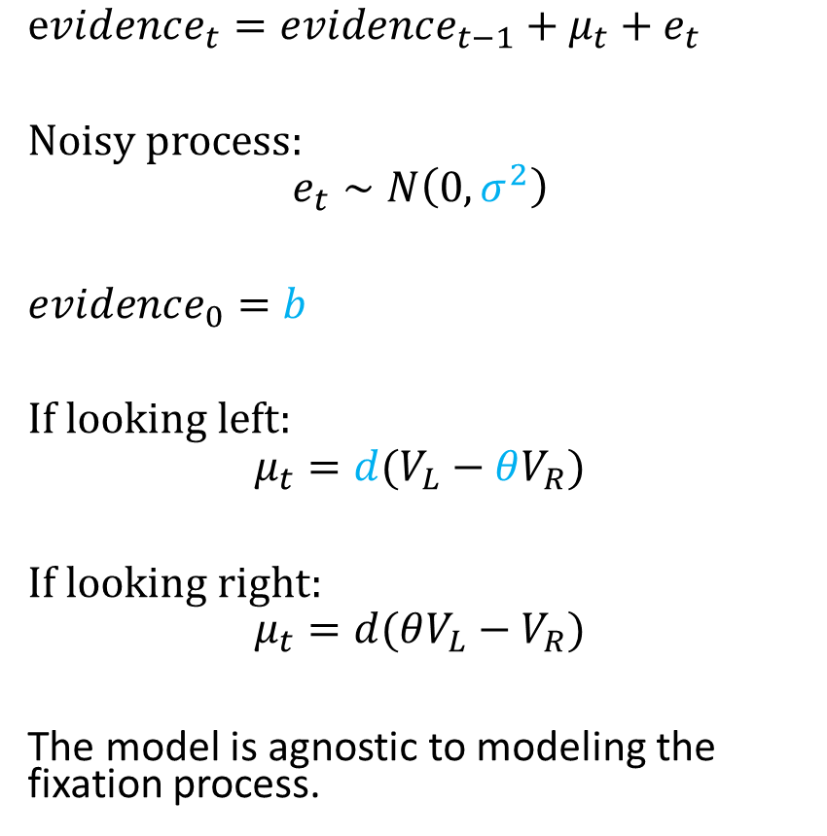
Attentional Drift-Diffusion-Model (aDDM)
$evidence_{t}=evidence_{t−1}+μ_{t}+e_{t}$
Noisy process:
$$e_{t}∼N\left(0, σ^{2}\right)$$
$evidence_{0}=b$
If looking left:
$$μ_{t}=d(V_{L}−θV_{R})$$
If looking right:
$$μ_{t}=d(θV_{L}−V_{R})$$
The model is agnostic to modeling the fixation process.
Notes:
noisy
bias
drift: ddm in value based decisions: evidence accumulated is value comparison
drift
sim
explain fixation sampling process

Slide 6
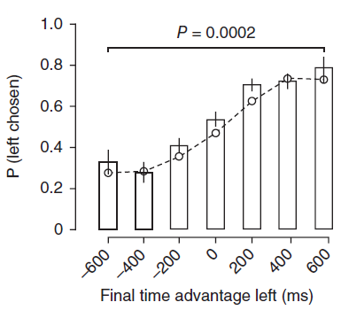
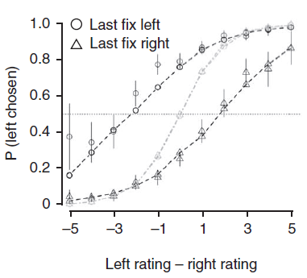
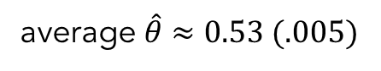
aDDM Predictions
average $\hat{θ}≈0.53 (.005)$
1. Attentional Discounting
2. Net Fixation Bias
3. Last Fixation Bias
Bhatnagar, Orquin (2022, J Exp Psychol Gen)
Krajbich, Armel, Rangel (2010, Nat Neuro)

Slide 7
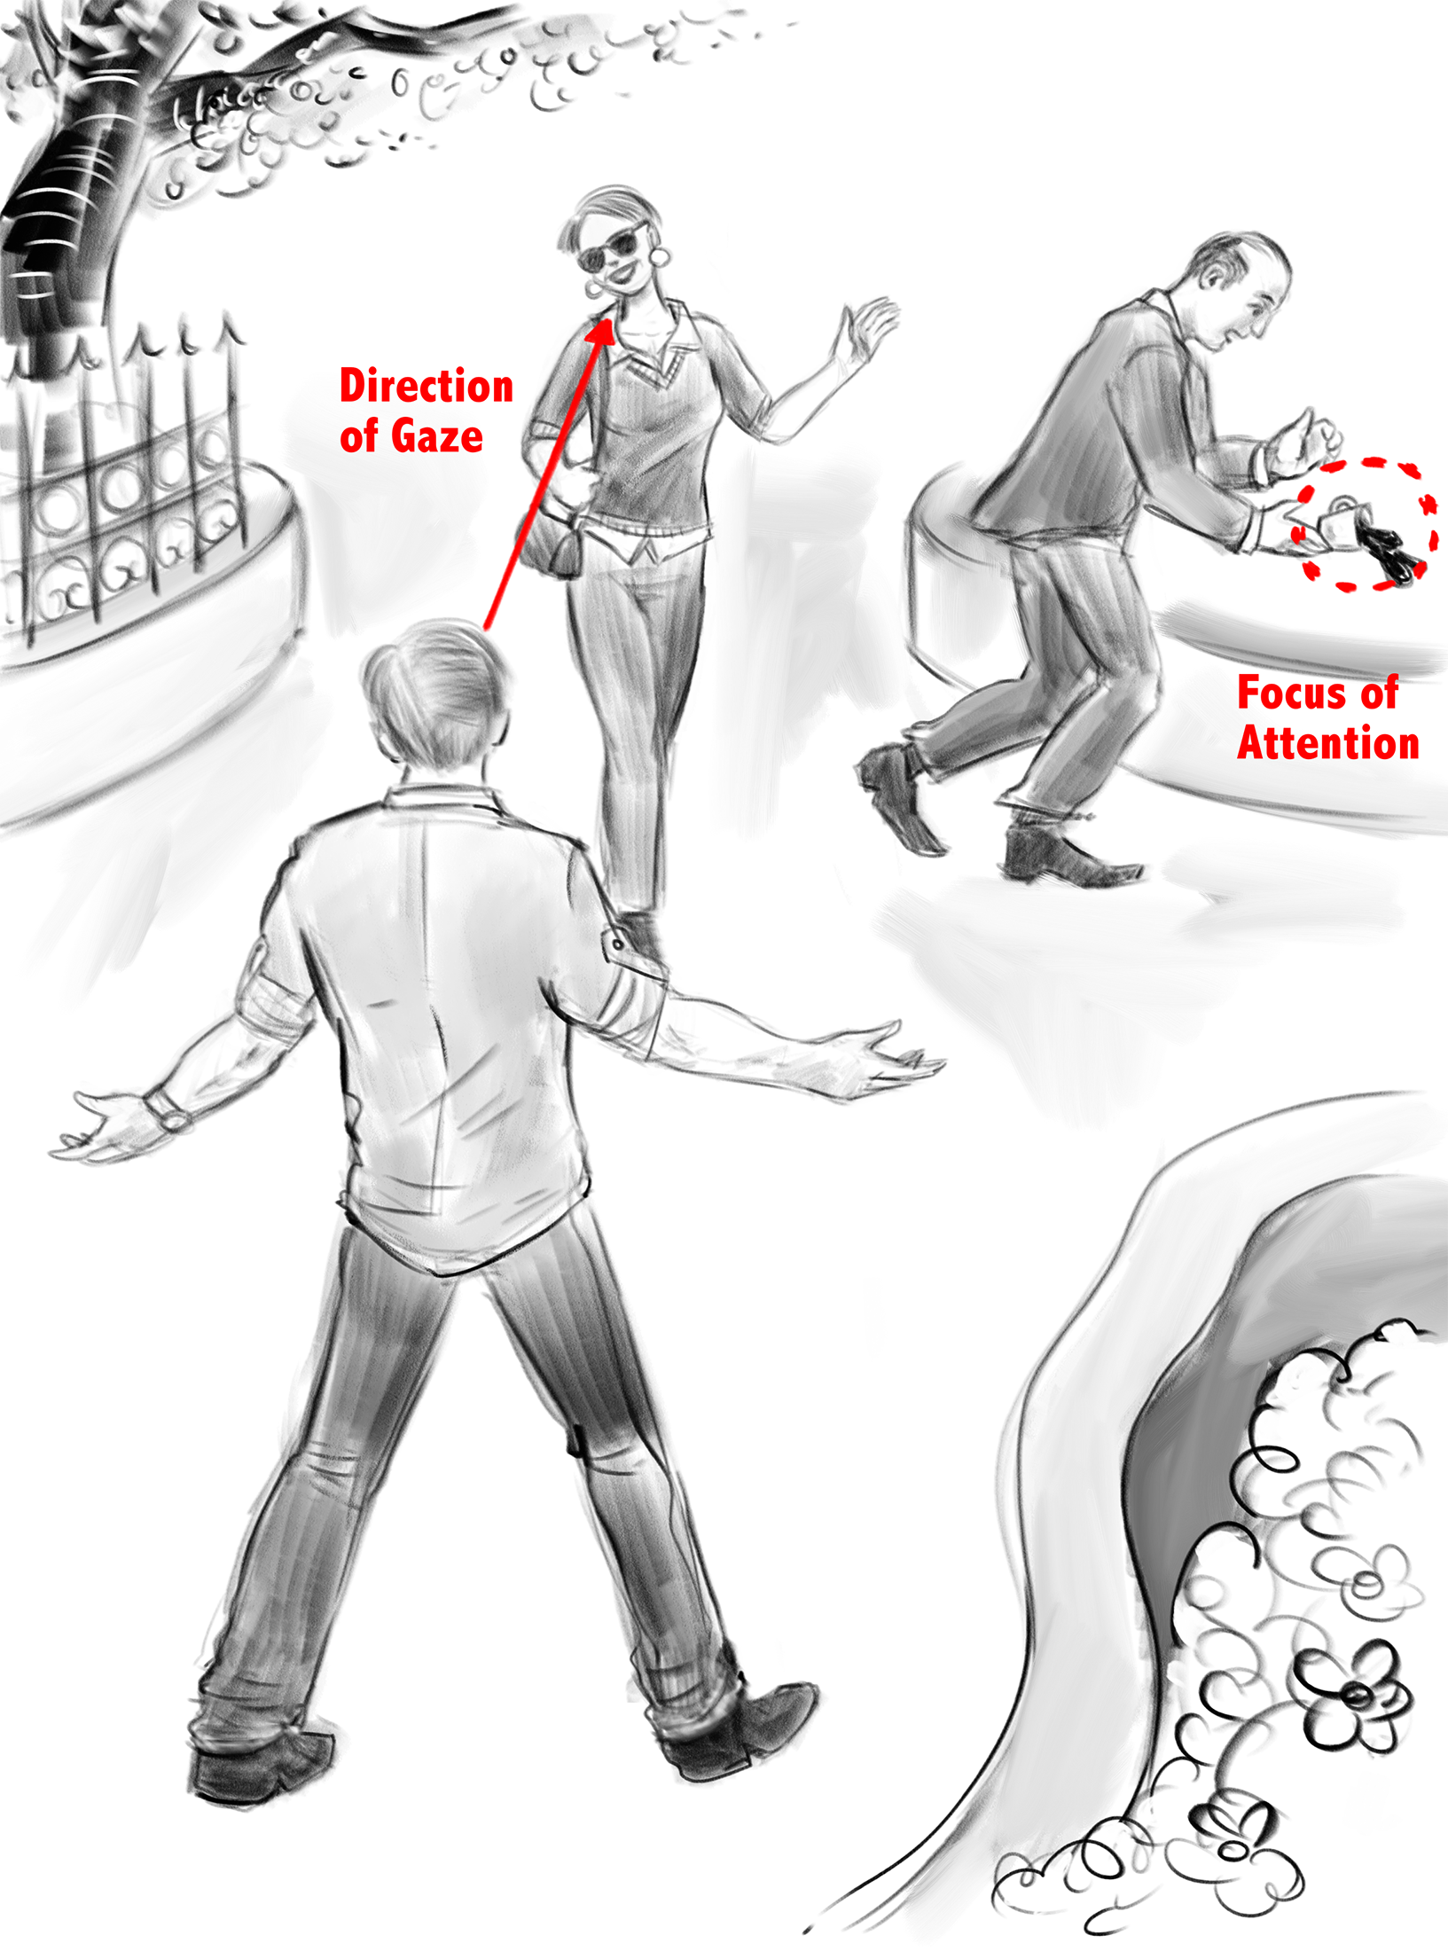
Overt vs Covert Attention
Drawing by Dr. Peter Coppin, OCAD
Notes:
overt
covert
bulk of literature overt

Slide 8



Slide 10
Does peripheral visual information play a role in the decision-making process?

Slide 11


Slide 12
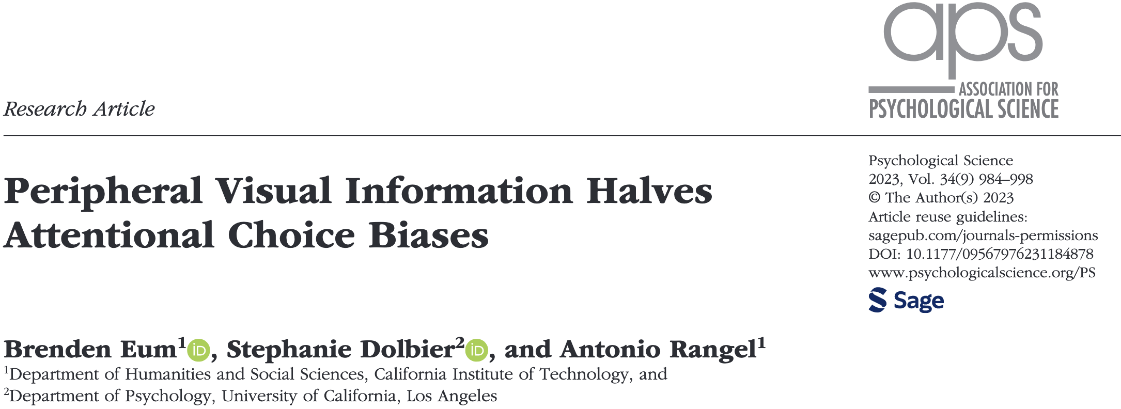

Slide 13
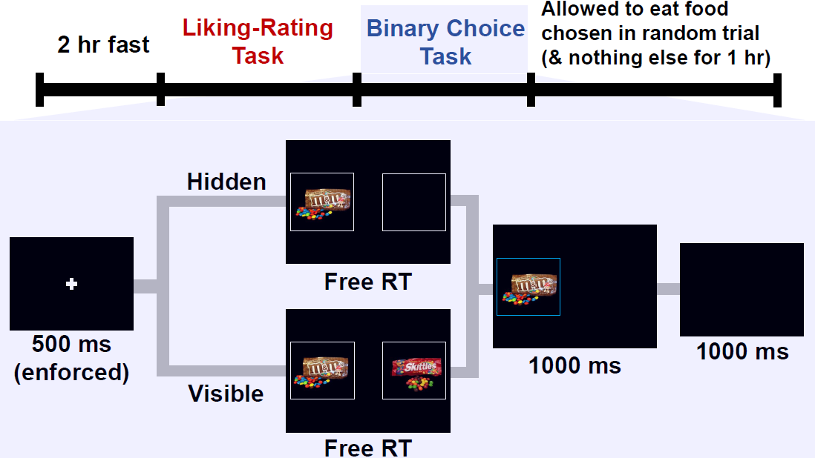
Notes:
liking ratings provide an independent measure of value

Slide 14
Questions
Does removing peripheral visual information affect our choices?
If so, how is it affecting our choices?
Does it change our fixation process?
Does it change our value comparison process?

Slide 15
Inference Strategy
Exploratory Sample
N = 25
360 trials

Slide 16
Inference Strategy
Exploratory Sample
N = 25
360 trials
Confirmatory Sample
N = 25
400 trials

Slide 17
Inference Strategy
Joint Dataset
Exploratory Sample
N = 25
360 trials
Confirmatory Sample
N = 25
400 trials

Slide 18
Does removing peripheral visual information affect our choices?

Slide 19
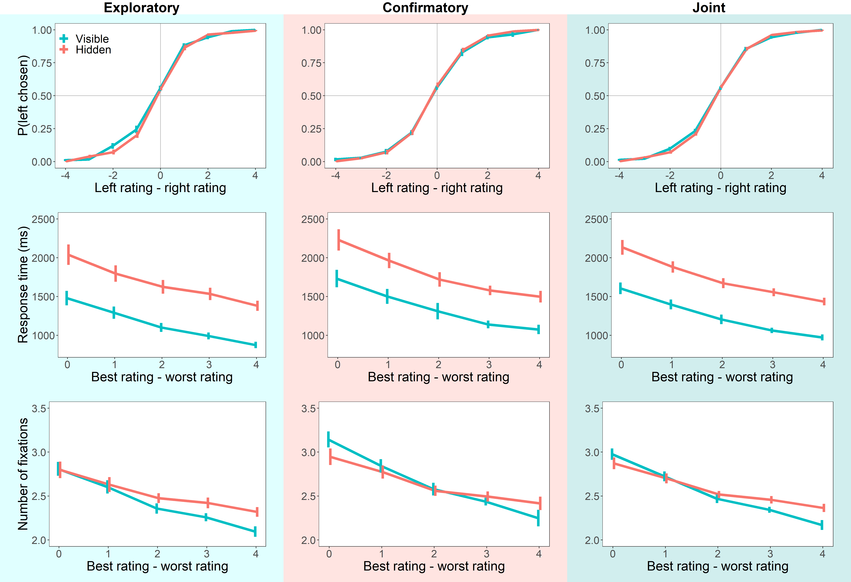
Average Choices and Response Times

Slide 20
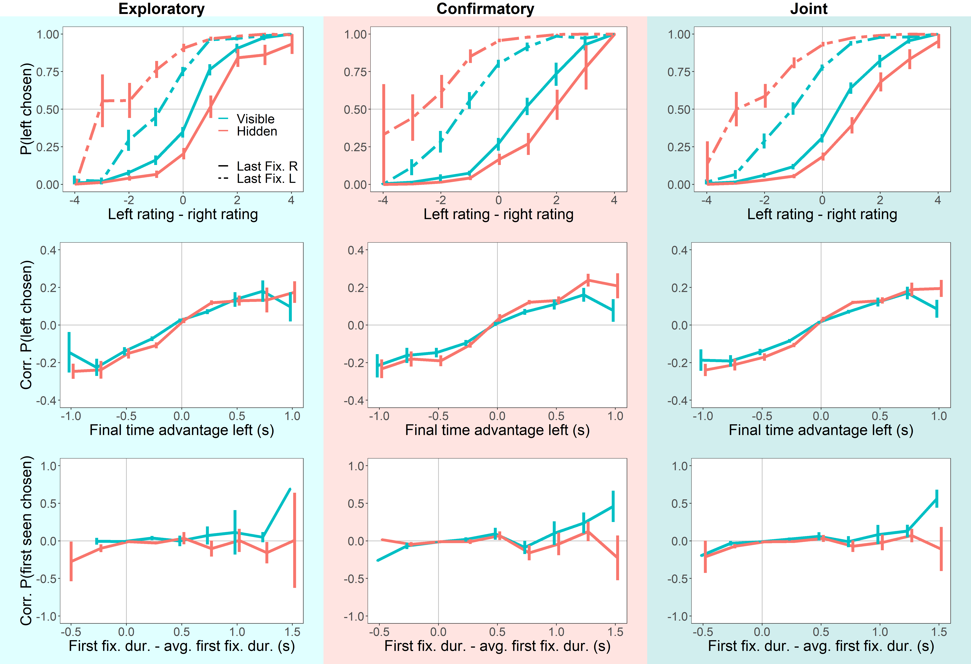
Attentional Choice Biases
Last Fix. Bias

Slide 21
Attentional Choice Biases
Net Fix. Bias

Slide 22
Questions
Does removing peripheral visual information affect our choices?

Slide 23
Questions
Does removing peripheral visual information affect our choices?
Yes

Slide 24
Questions
Does removing peripheral visual information affect our choices?
If so, how is it affecting our choices?
Does it change our fixation process?
Yes

Slide 25
Does removing peripheral visual information affect our fixation process?

Slide 26
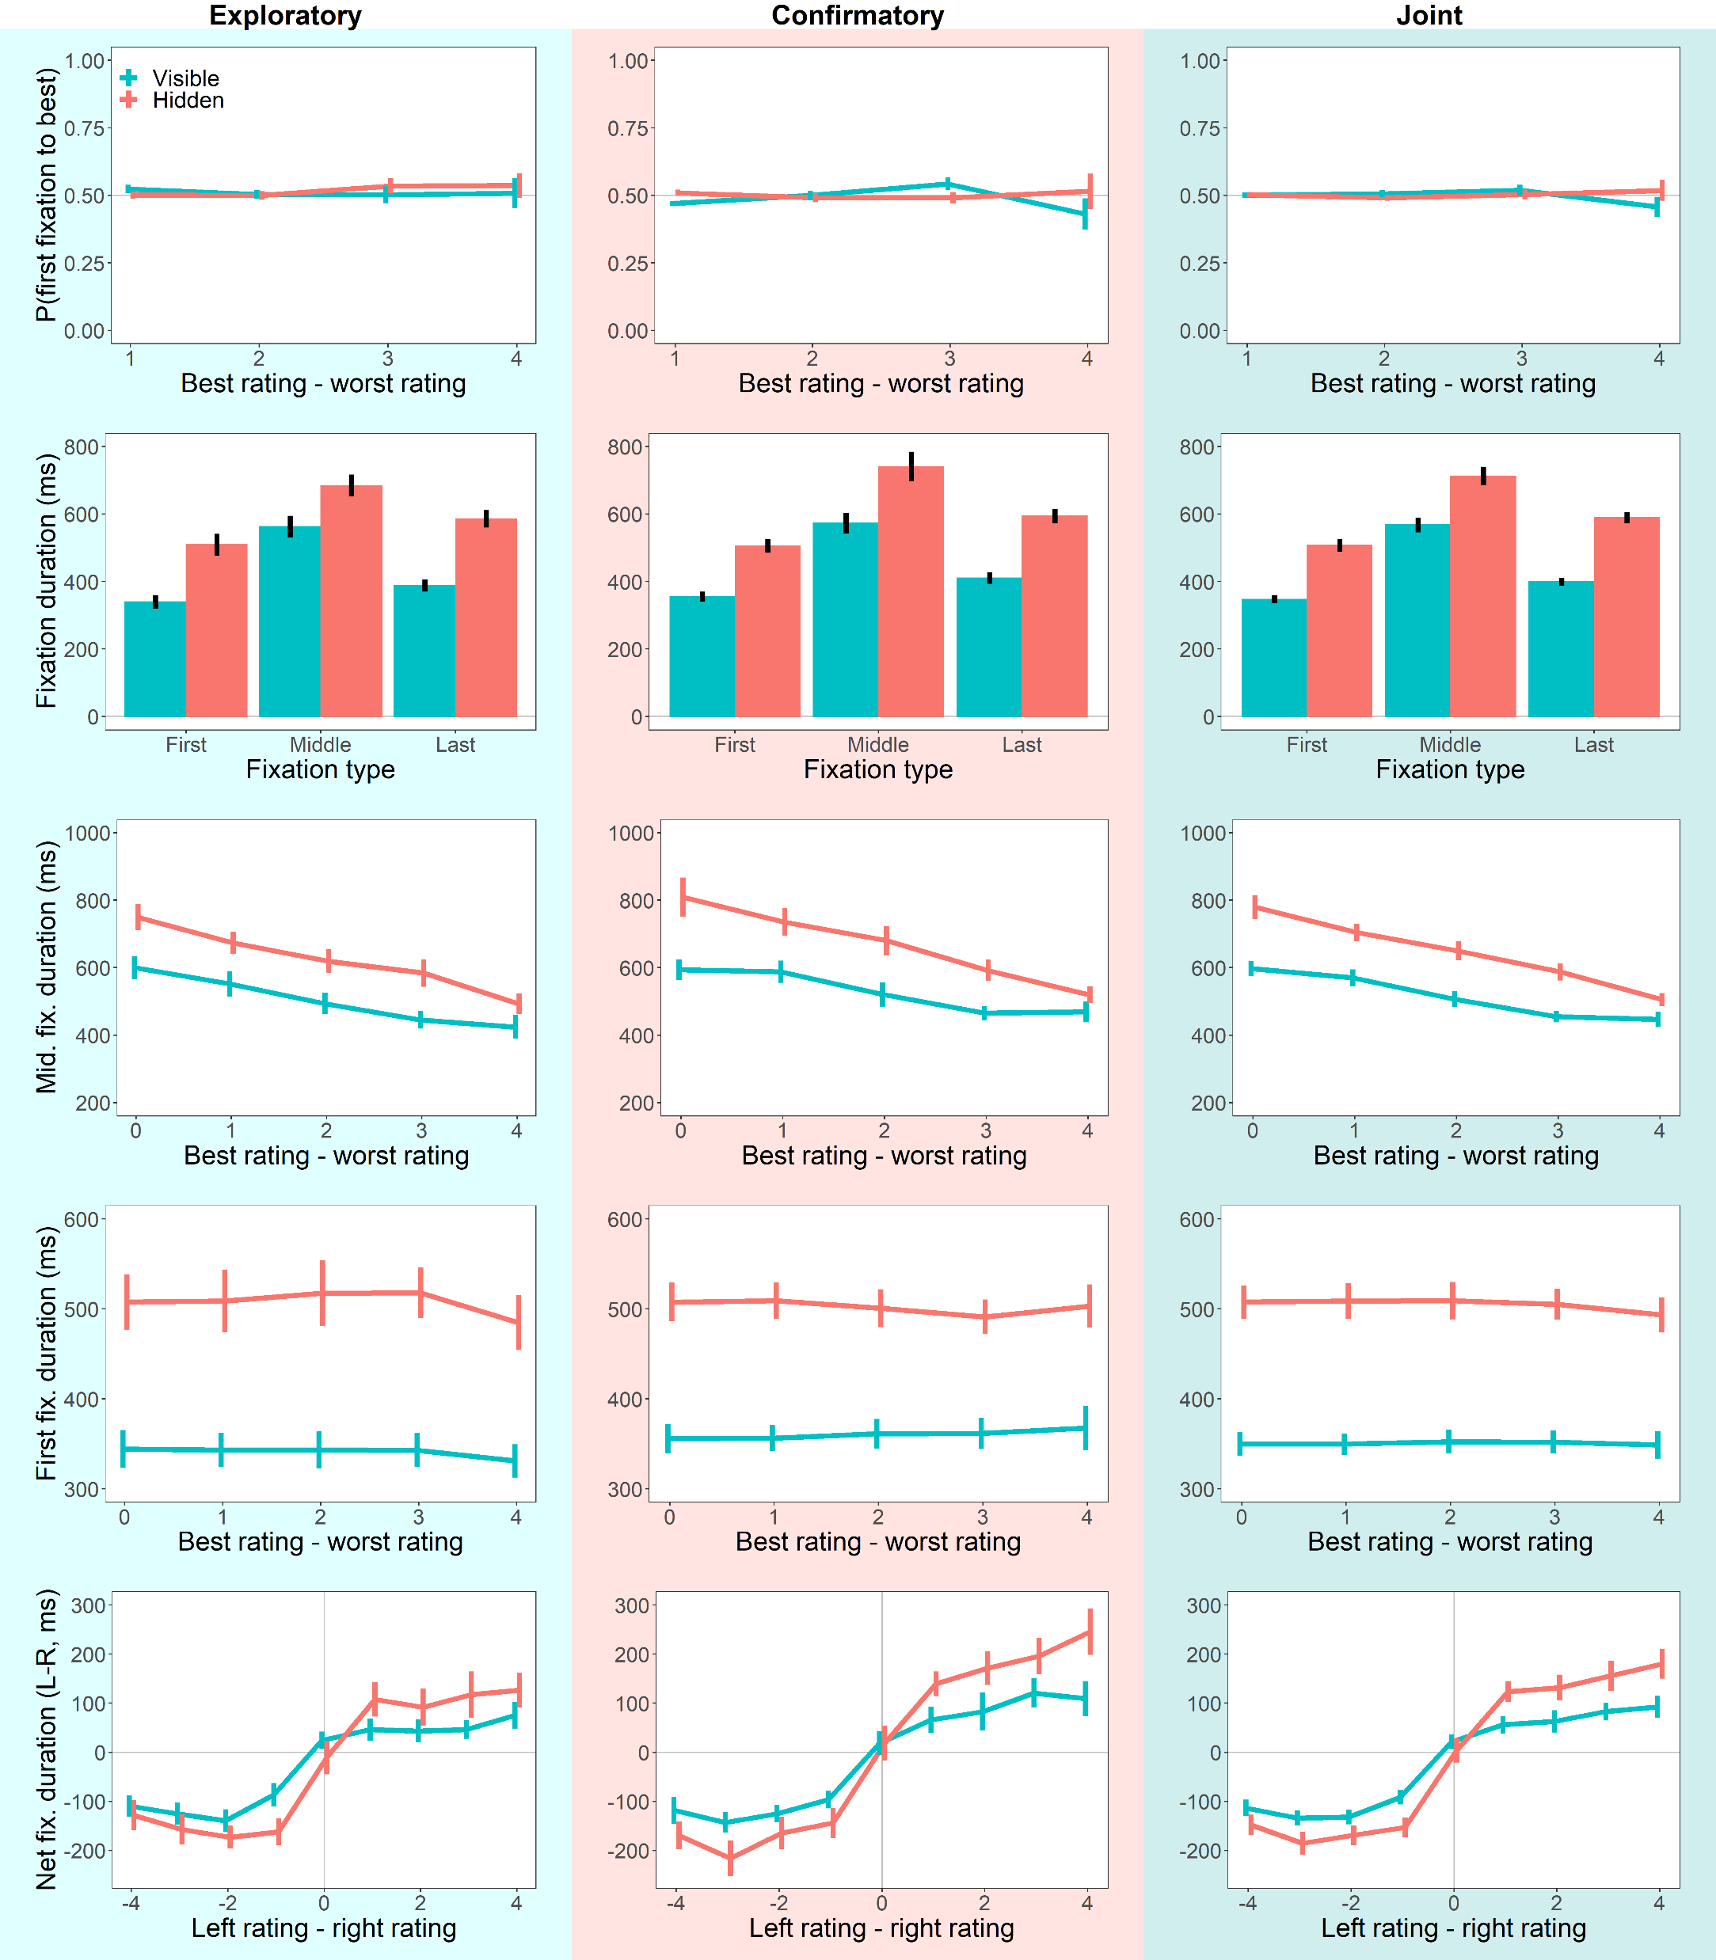
Fixation Process

Slide 27
Net Fixation

Slide 28
Questions
Does removing peripheral visual information affect our choices?
If so, how is it affecting our choices?
Does it change our fixation process?
Yes

Slide 29
Questions
Does removing peripheral visual information affect our choices?
If so, how is it affecting our choices?
Does it change our fixation process?
Does it change our value comparison process?
Yes

Slide 30
Does removing peripheral visual information affect the value comparison process?

Slide 31
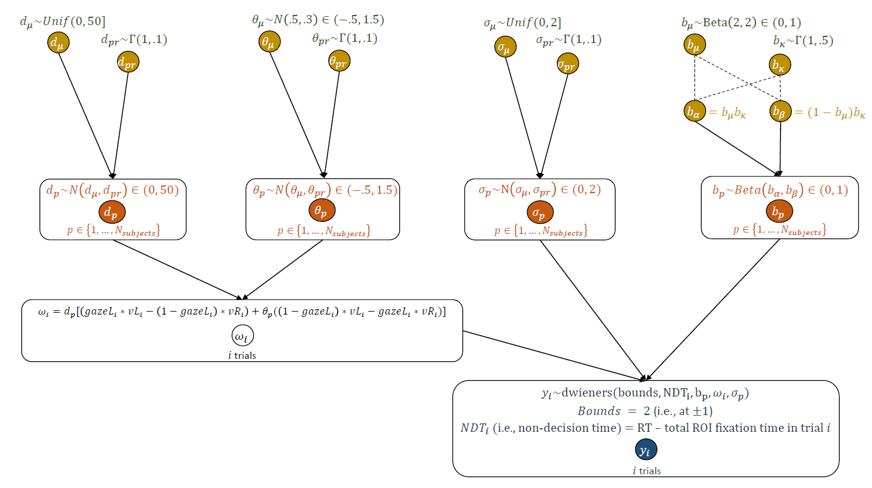
Hierarchical Bayesian aDDM
Group-Level
Individual-Level
Lombardi & Hare Toolbox (2021)
Notes:
estimates the parameters of the aDDM in a fraction of the time compared to previous toolboxes
gives full posteriors, which allows for hypothesis testing

Slide 32
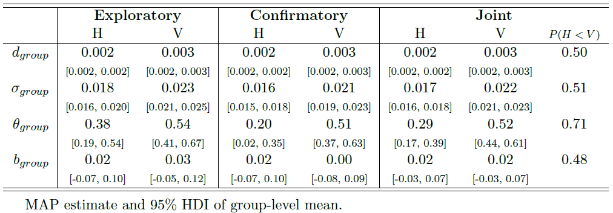
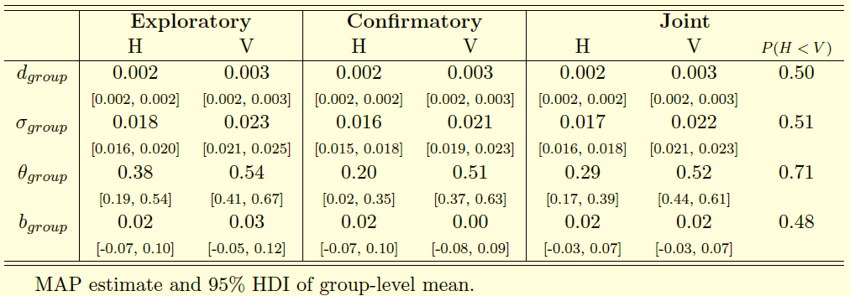
MAP Estimates of Group-Level Mean
speed of accumulation
noise
attentional discounting
biased starting point
Notes:
what do the parameters mean?
drift and noise smaller.
beta same.
key point: theta.

Slide 33
Questions
Does removing peripheral visual information affect our choices?
If so, how is it affecting our choices?
Does it change our fixation process?
Does it change our value comparison process?
Yes

Slide 34

Questions
Does removing peripheral visual information affect our choices?
If so, how is it affecting our choices?
Does it change our fixation process?
Does it change our value comparison process?
What is the relative importance of the different mechanisms?

Slide 35
Out-of-Sample Simulations

Slide 36
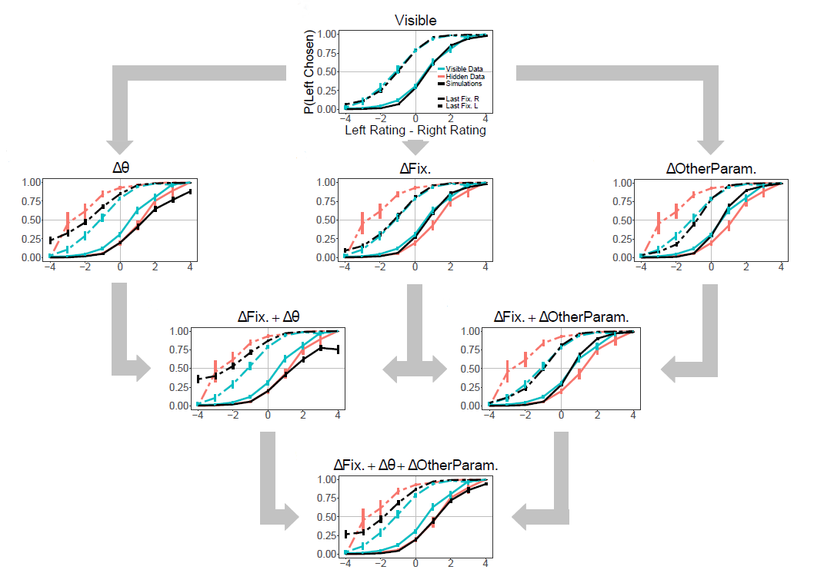
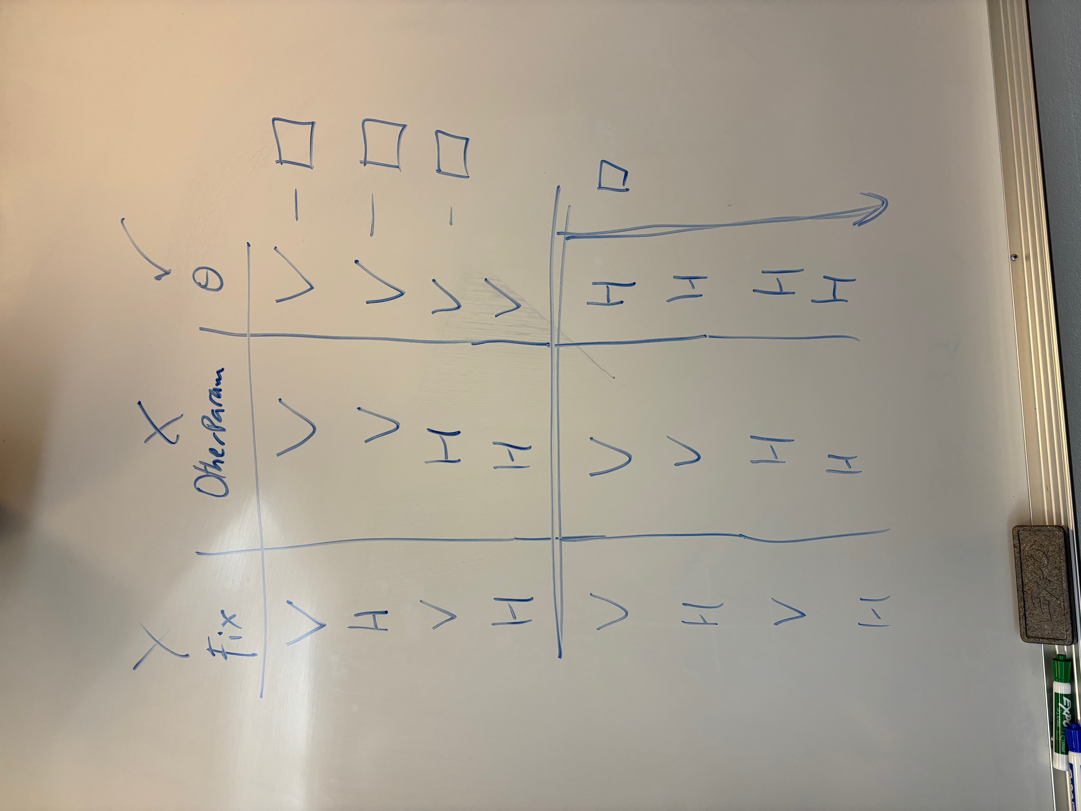

Slide 37
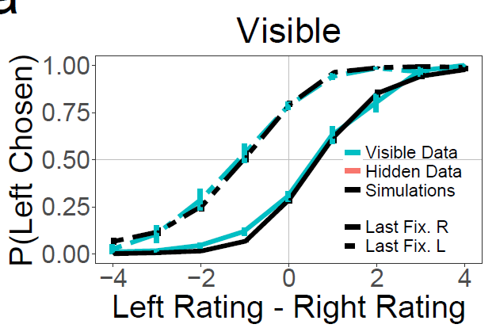

Slide 38
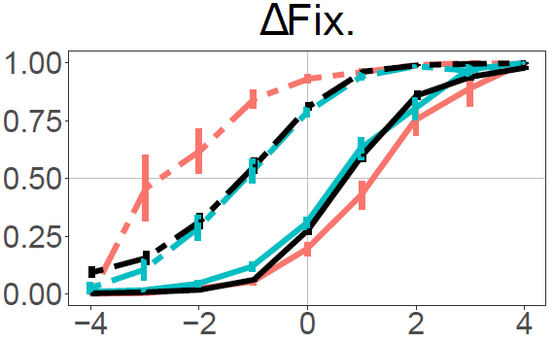

Slide 39
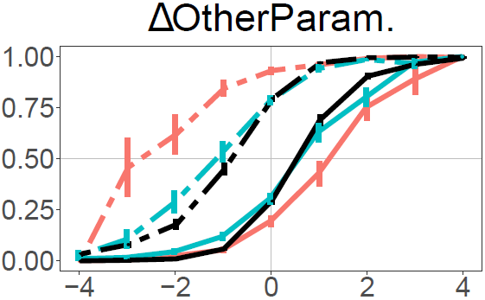

Slide 40
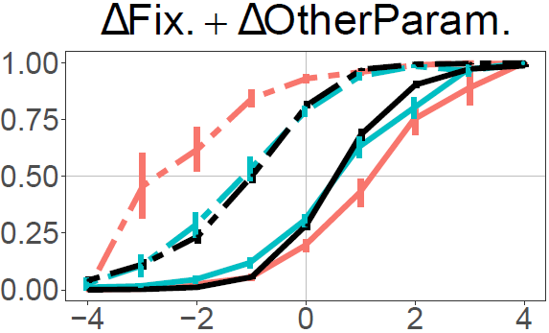

Slide 41
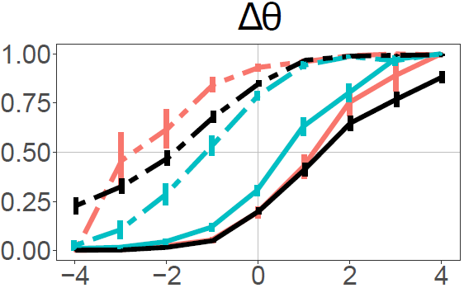

Slide 42
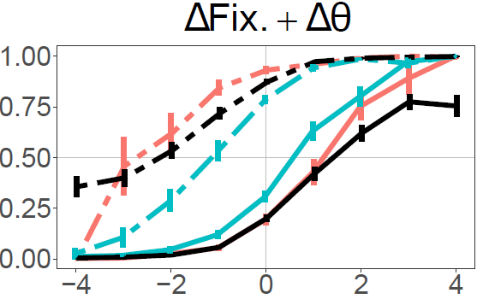

Slide 43
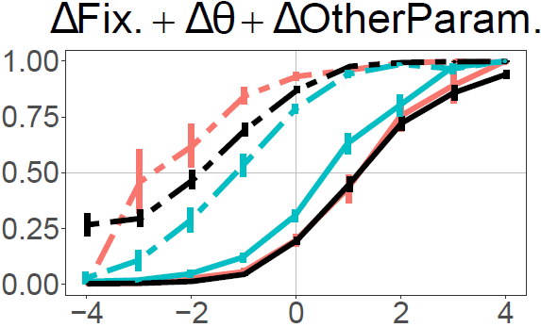

Slide 44
Questions
Does removing peripheral visual information affect our choices?
If so, how is it affecting our choices?
Does it change our fixation process?
Does it change our value comparison process?
What is the relative importance of the different mechanisms?

Slide 45

Questions
Does removing peripheral visual information affect our choices?
If so, how is it affecting our choices?
Does it change our fixation process?
Does it change our value comparison process?
Removing peripheral visual information is affecting our choices primarily through the value comparison process, not the fixation process.

Slide 46
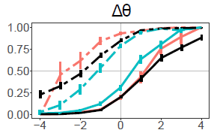
Summary
Removing peripheral visual information…
has minimal impact on average quality of choices, but doubles the magnitude of attentional choice biases.
slows down fixations by about 30%.
primarily affects attentional choice biases via an attentional discounting mechanism during value comparison.

Slide 49



Slide 50
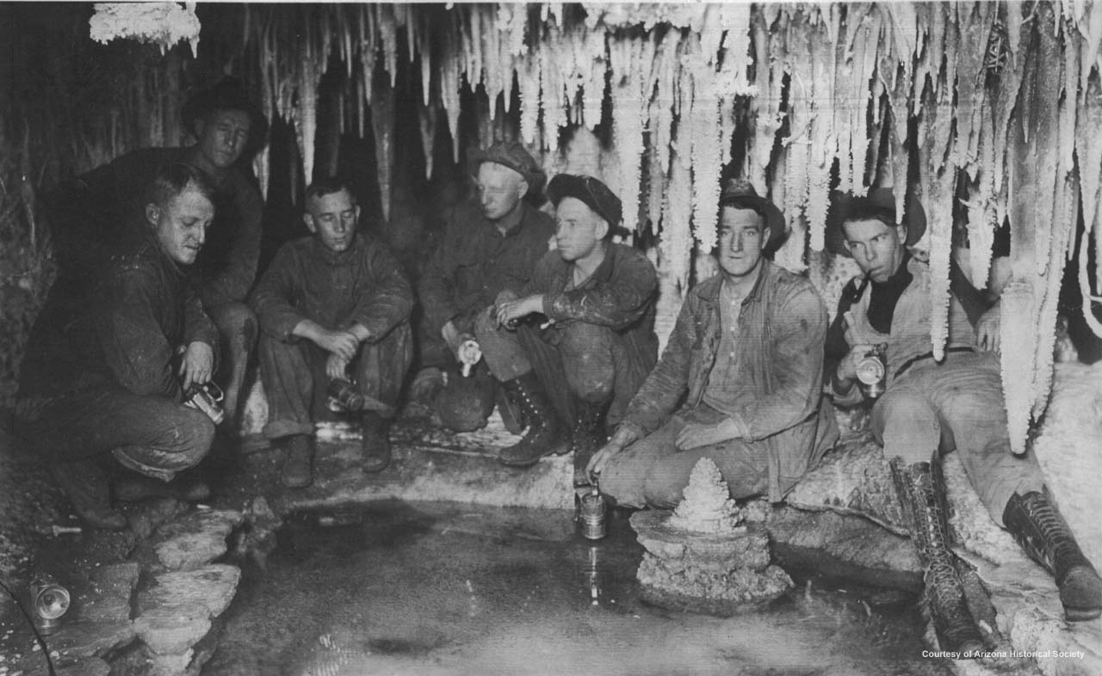
Copper Miners in Bisbee, Arizona
Notes:
Copper Miners in Bisbee, Arizona

Slide 51
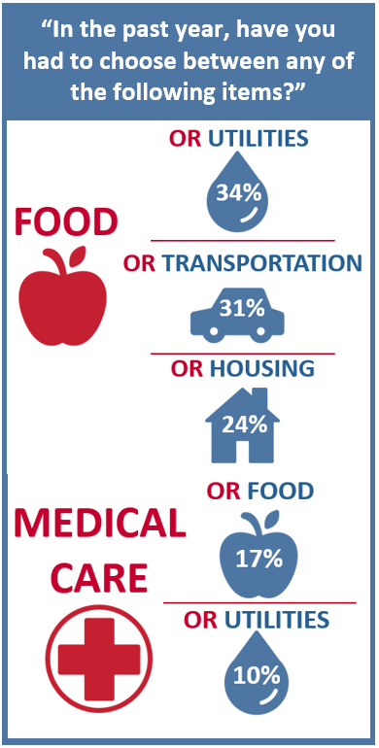
The Center for Community Solutions, Cleveland, Ohio

Slide 52
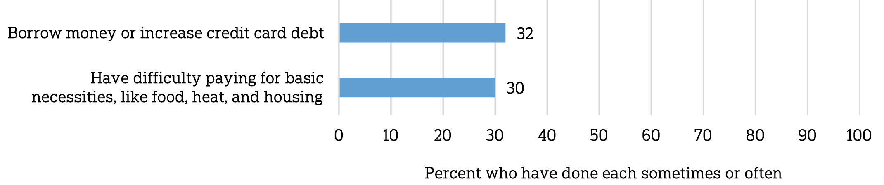
Does paying for healthcare costs cause you to…
The Center for Community Solutions, Cleveland, Ohio
NORC @ U Chicago / West Health Institute (2018)

Slide 54
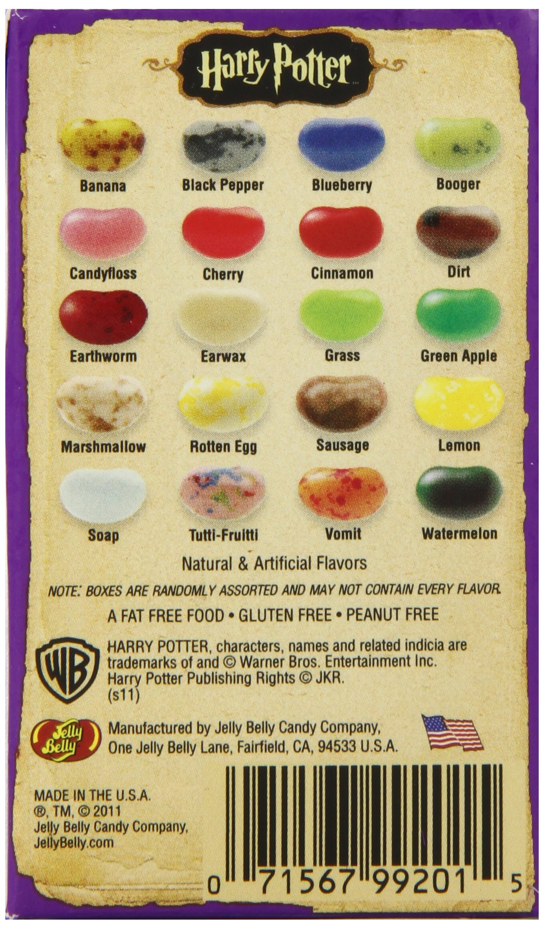

Slide 55
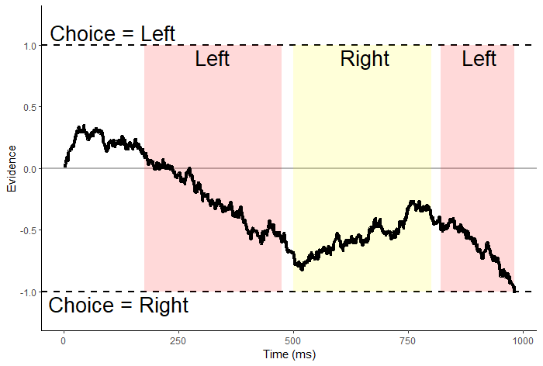
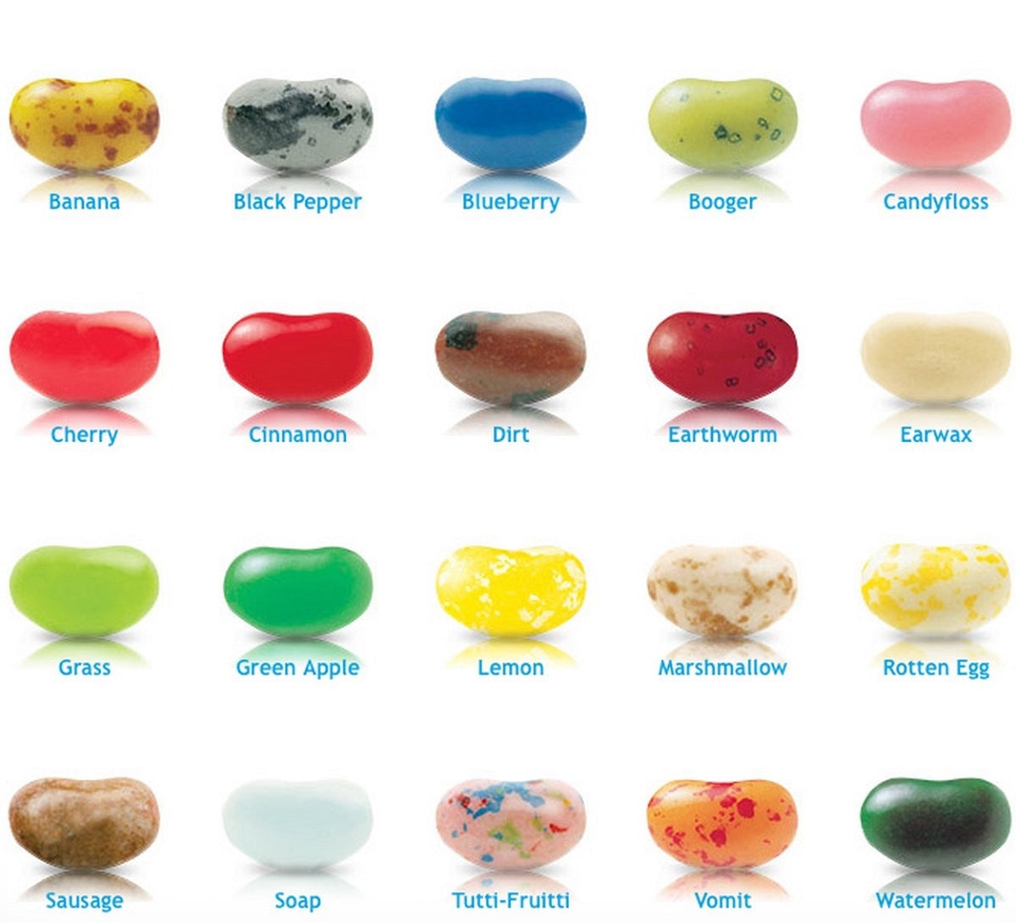
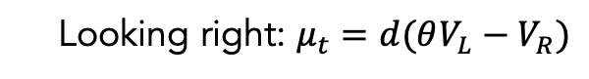

$evidence_{t}=evidence_{t−1}+μ_{t}+e_{t}$
Looking left: $μ_{t}=d(V_{L}−θV_{R})$
Looking right: $μ_{t}=d(θV_{L}−V_{R})$

Slide 56
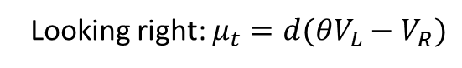
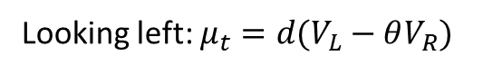
$evidence_{t}=evidence_{t−1}+μ_{t}+e_{t}$
Looking left: $μ_{t}=d(V_{L}−θV_{R})$
Looking right: $μ_{t}=d(θV_{L}−V_{R})$
If attentional discounting persists in choices between losses,
then the value of the nonfixated option should seem less negative
(i.e. better than it actually is).

Slide 57
Attentional choice biases
Net Fixation Bias
Last Fixation Bias
Pr(Left Chosen)
Pr(Choose Last Fix.)
Final Time Advantage Left
Left Rating - Right Rating

Slide 58
Attentional choice biases
should flip!
Net Fixation Bias
Last Fixation Bias
Pr(Left Chosen)
Pr(Choose Last Fix.)
Final Time Advantage Left
Left Rating - Right Rating

Slide 59
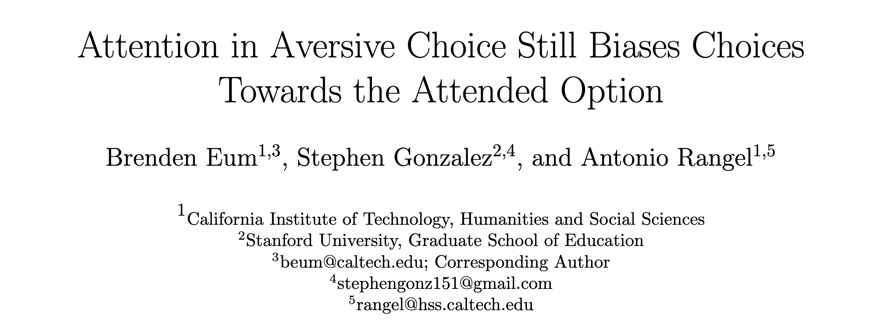
* title pending

Slide 60
Attention in Risky Gains
Attention in Losses

Slide 61
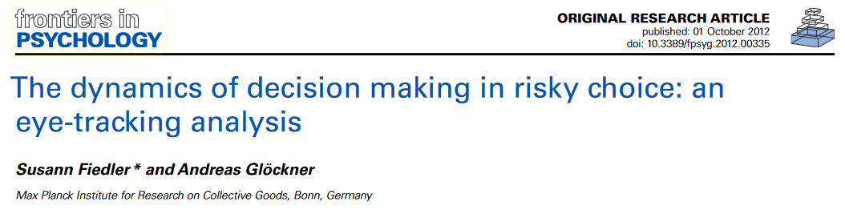
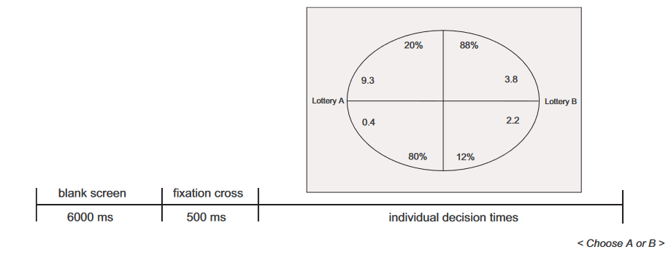
Attention in Risky Gains
Attention in Losses

Slide 62
Attention in Risky Gains
Attention in Losses

Slide 63
Attention in Risky Gains
Attention in Losses

Slide 64
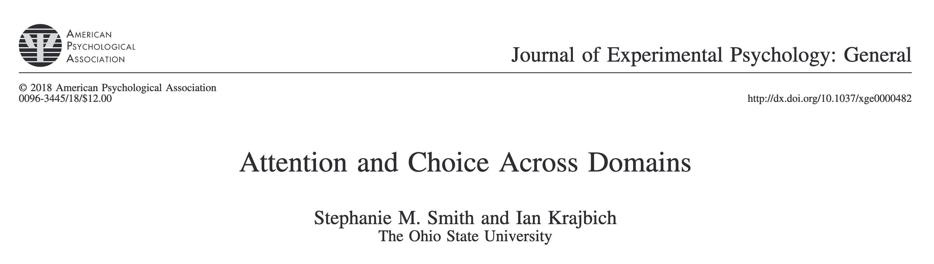

Attention in Risky Gains
Attention in Losses

Slide 65
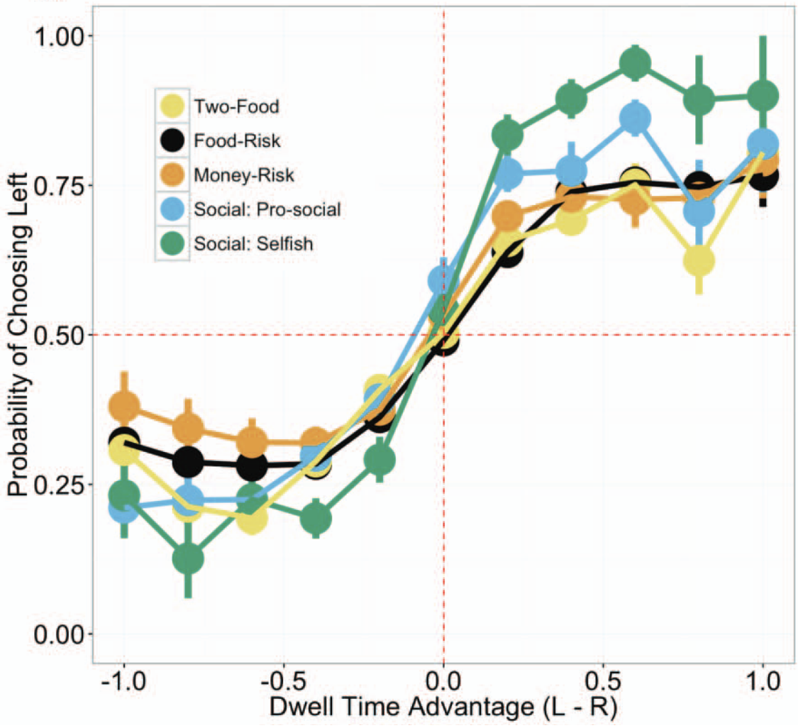
Attention in Risky Gains
Attention in Losses

Slide 66
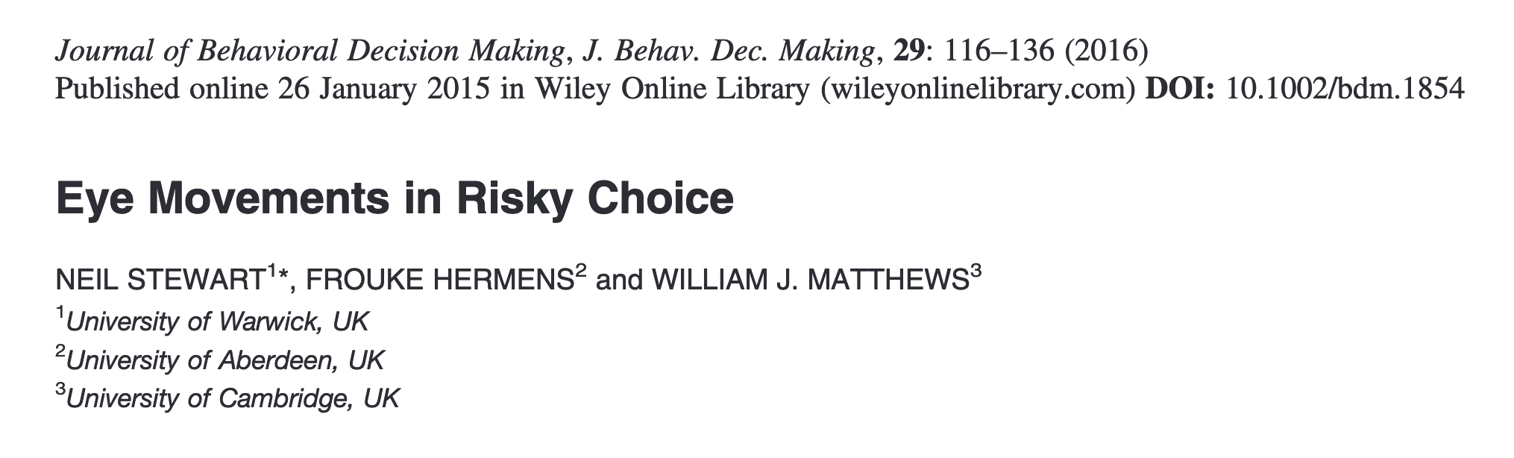
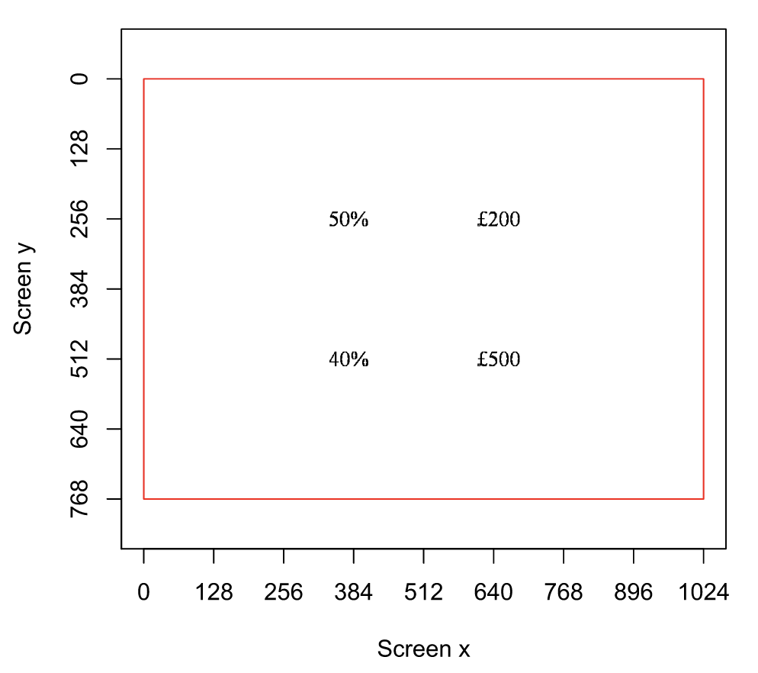
Attention in Risky Gains
Attention in Losses

Slide 67
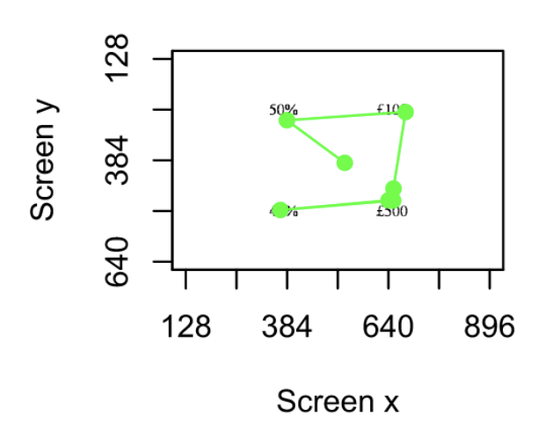
Attention in Risky Gains
Attention in Losses
Notes:
All attributes fixed roughly equally. Transition matrix stable across and within choices. Value independence from a logistic regression of choice on ___ variables and an interaction between #(fixations) and attribute value (4x: for each attribute). Either small or insignificant coefficients.

Slide 68
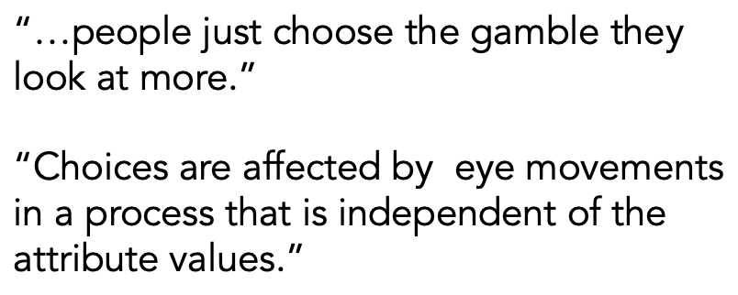
Attention in Risky Gains
Attention in Losses
Notes:
All attributes fixed roughly equally. Transition matrix stable across and within choices. Value independence from a logistic regression of choice on ___ variables and an interaction between #(fixations) and attribute value (4x: for each attribute). Either small or insignificant coefficients.

Slide 69
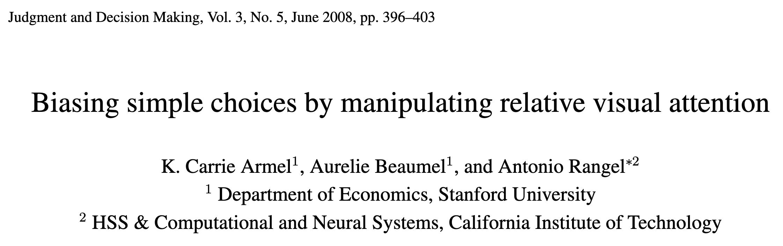
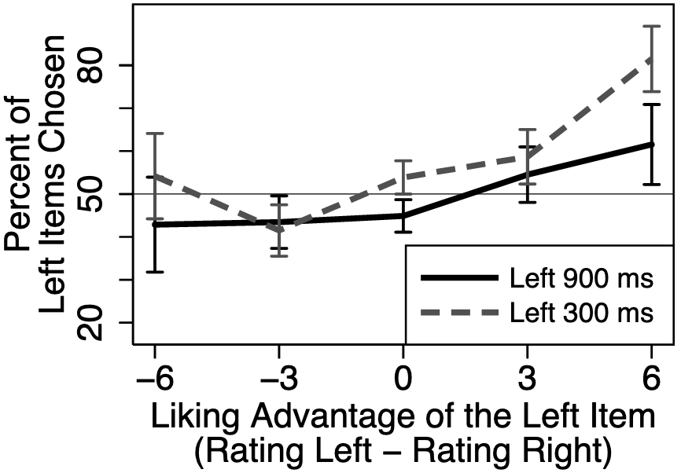
Attention in Risky Gains
Attention in Losses

Slide 70
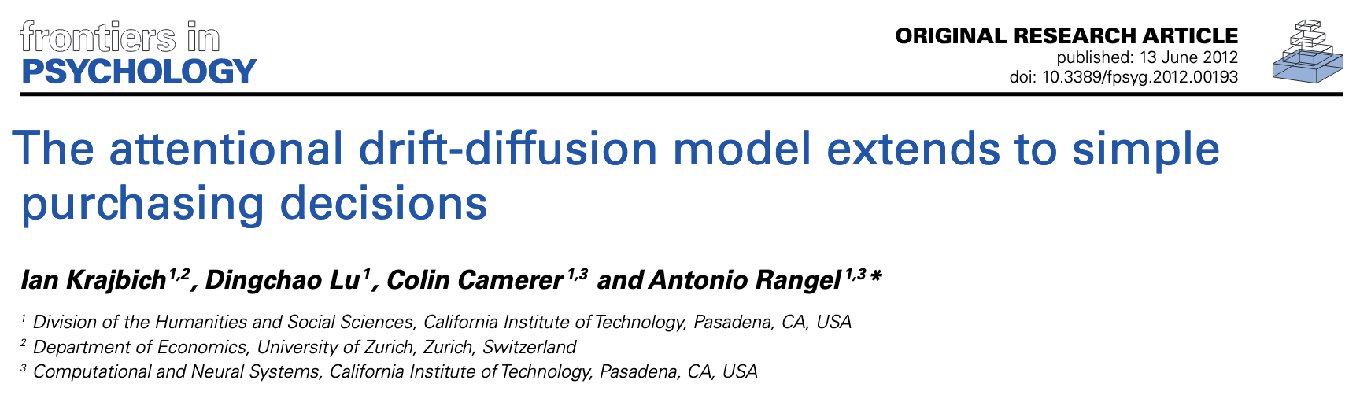

Attention in Risky Gains
Attention in Losses

Slide 71


Attention in Risky Gains
Attention in Losses
Notes:
All attributes fixed roughly equally. Transition matrix stable across and within choices.

Slide 72

Attention in Risky Gains
Attention in Losses
Notes:
All attributes fixed roughly equally. Transition matrix stable across and within choices.

Slide 73


Slide 74


Slide 75
Basic Psychometrics

Slide 76
Basic Psychometrics

Slide 77
Fixation Process

Slide 78
Predicted Attentional Choice Bias Reversals
Net Fixation Bias
Last Fixation Bias
Pr(Left Chosen)
Pr(Choose Last Fix.)
Final Time Advantage Left
Left Rating - Right Rating

Slide 79
Attentional Choice Biases
Net Fixation Bias
Last Fixation Bias
Pr(Left Chosen)
Pr(Choose Last Fix.)
Final Time Advantage Left
Left Rating - Right Rating

Slide 80
Attentional Choice Biases
Net Fixation Bias
Last Fixation Bias
Pr(Left Chosen)
Pr(Choose Last Fix.)
Final Time Advantage Left
Left Rating - Right Rating

Slide 81
Can we extend the aDDM to explain parallel attentional choice biases in the gain and loss conditions?

Slide 82


$evidence_{t}=evidence_{t−1}+μ_{t}+e_{t}$
Assumption 1 (Attention):
The effect of attention on the choice process is bounded and value- dependent.
$$μ_{t}:=\left\{\begin{aligned}\begin{aligned}d\left(V_{L}−θV_{R}\right), fixated right \\ &d(θV_{L}−V_{R}), fixated right\end{aligned} \\ 0, otherwise\end{aligned}\right.$$
$$θ∈[0,1]$$
Assumption 2 (Value Function):
Value signal inputs to the model are not transformed.
$$f\left(V_{i}\right)=V_{i}$$

Slide 83

Unbounded
Additive
Divisive Normalized
Goal-Dependent
Range Normalized
Range Norm. + Additive
Dynamic Range Norm. + Additive

Slide 84
Unbounded
Additive
Goal-Dependent

Slide 85

Unbounded
Additive
Divisive Normalized
Goal-Dependent
Range Normalized
Range Norm. + Additive
Dynamic Range Norm. + Additive

Slide 86
Unbounded
Additive
Divisive Normalized
Goal-Dependent
Range Normalized
Range Norm. + Additive
Dynamic Range Norm. + Additive

Slide 87
Unbounded
Additive
Divisive Normalized
Goal-Dependent
Range Normalized
Range Norm. + Additive
Dynamic Range Norm. + Additive

Slide 88


Unbounded
Additive
Intuition Police:
What the heck does $θ>1$ intuitively mean?
Divisive Normalized
Goal-Dependent
Range Normalized
Range Norm. + Additive
Dynamic Range Norm. + Additive

Slide 89

Intuition for $θ∈(0,1)$
V( ) = V( )
See Jang, Sharma, Drugowitsch (2021, eLife); Callaway, Rangel, Griffiths (2021, PLoS Comput Bio)

Slide 90


Intuition for $θ∈(0,1)$
V( ) sample
Evidence
V( ) = V( )
Time
V( ) sample
See Jang, Sharma, Drugowitsch (2021, eLife); Callaway, Rangel, Griffiths (2021, PLoS Comput Bio)

Slide 91
Intuition for $θ>1$
V( ) sample
V( ) sample
See Jang, Sharma, Drugowitsch (2021, eLife); Callaway, Rangel, Griffiths (2021, PLoS Comput Bio)

Slide 92
Unbounded
Additive
Divisive Normalized
Goal-Dependent
Range Normalized
Range Norm. + Additive
Dynamic Range Norm. + Additive

Slide 93
Unbounded
Additive
Divisive Normalized
Goal-Dependent
Range Normalized
Range Norm. + Additive
Dynamic Range Norm. + Additive

Slide 94
Unbounded
Additive
Divisive Normalized
Goal-Dependent
Range Normalized
Range Norm. + Additive
Dynamic Range Norm. + Additive

Slide 96
Unbounded
Additive
Divisive Normalized
Goal-Dependent
Range Normalized
Range Norm. + Additive
Dynamic Range Norm. + Additive

Slide 97
Unbounded
Additive
Divisive Normalized
Goal-Dependent
Range Normalized
Range Norm. + Additive
Dynamic Range Norm. + Additive

Slide 100
Unbounded
Additive
Divisive Normalized
Goal-Dependent
Range Normalized
Range Norm. + Additive
Dynamic Range Norm. + Additive

Slide 101
If attentional bias is multiplicative…

Slide 102
If attentional bias is additive…

Slide 103
But this doesn’t look additive either…

Slide 104
Summary
Attention is pulling choices towards the attended item in both choices between gains and between losses.
This is surprising given previous studies and the predictions of the standard aDDM.
The additive model of attention or the aDDM with goal-dependent evidence are capable of explaining the lack of attentional bias reversals in aversive choice.

